Slide 1
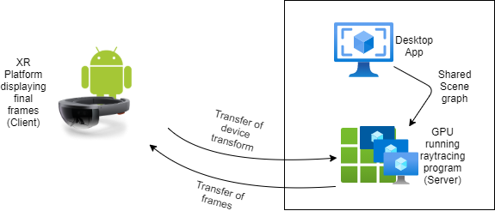
Remote Rendering for XR
By- Gizem Dal, Dayu Li, Tushar Purang

Slide 2
Overview-MileStone 1
Progress in project
Video streaming client/server program.
Nvidia Optix path-tracer.
GPUnet.
Extraction of the hololens spatial mapping.
Researches and Studies
GPU level steaming and data transmission methods.
Real-time ray-tracer with global illuminations in XR.
Real-time ray-tracer using Unity.
Mesh-simplification methods.
Hololens gesture & spatial mapping APIs.

Slide 3
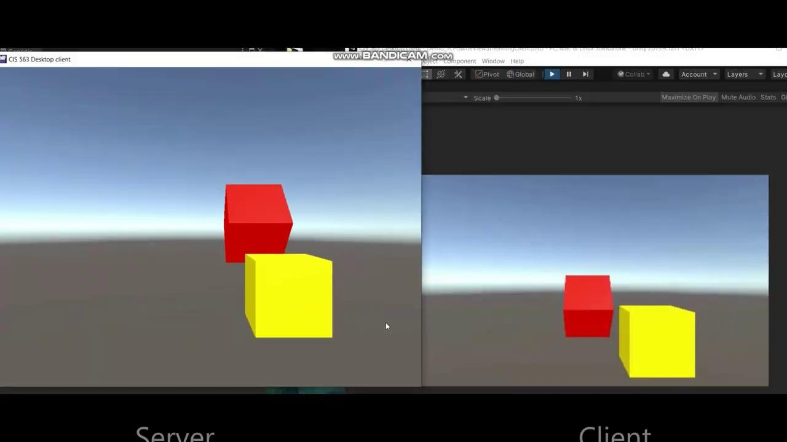
Tasks completed in milestone 1
Setting up desktop app (Video streaming to a client platform like android, hololens etc)

Slide 4
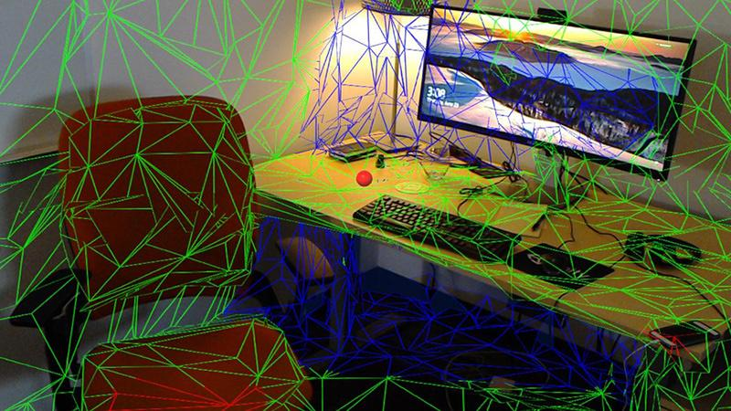
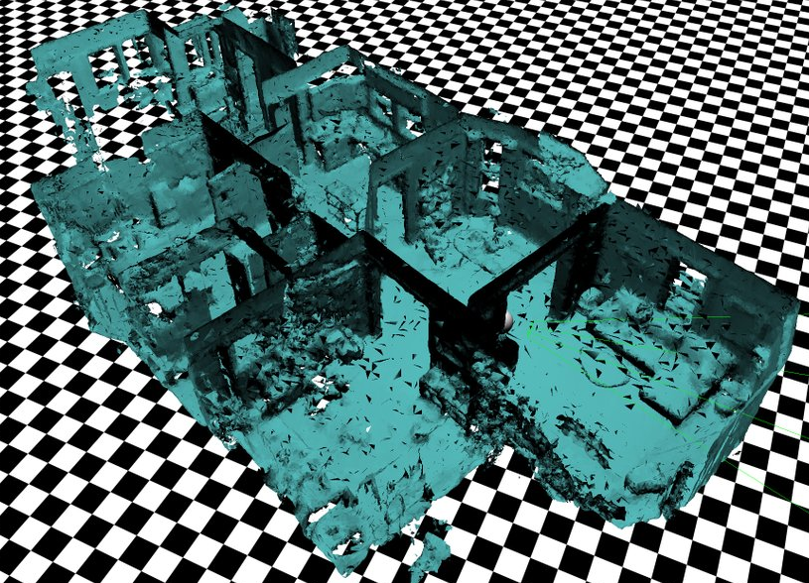
Tasks completed in milestone 1
GPUnet:
A native GPU networking layer
Extraction of the Hololens Spatial Mapping:
A scan of the real world as .obj format

Slide 5
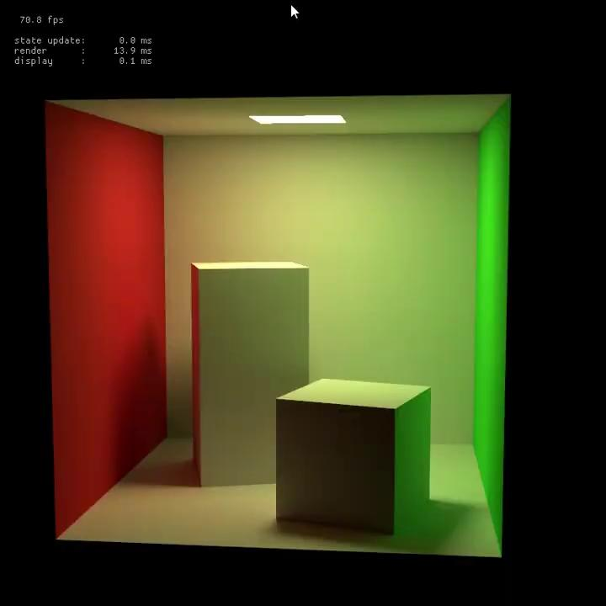
Tasks completed in milestone 1
Raytracer using the Nvidia Optix

Slide 6
Tasks planned for milestone 2
Streaming rendered frames of the raytracer to client platform.
Modifying Raytracer to process hand interaction and gestures captured by the Hololens.
Importing spatial mapping data from hololens into the raytracer for color bleeding effect.

Slide 7
Schedule
Milestone 1 – Nov 18th:
Basic Desktop app (Control Panel) + Hololens app
Milestone 2 – Nov 30th:
Hybrid Rendering (Scene + UI)
Real time ray tracing with only virtual light
Milestone 3 – Dec 7th:
Late Stage Reprojection for Hololens
Global illumination in augmented reality
Final – Dec 13:
Bug fixings and optimizations
Performance analysis
GPU networking + basic realtime raytracer

Slide 8
References
About Azure Remote Rendering https://docs.microsoft.com/en-us/azure/remote-rendering/overview/about
CPU-GPU Algorithms for Triangular Surface Mesh Simplification https://imr.sandia.gov/papers/imr21/Shontz.pdf
A Positional Timewarp Accelerator for Mobile Virtual Reality Devices https://escholarship.org/content/qt96r870gs/qt96r870gs_noSplash_4abbeba6bd4266514b1d56cbdd9dc5d7.pdf
Differential Irradiance Caching for Fast High-Quality Light Transport Between Virtual and Real Worlds https://publik.tuwien.ac.at/files/PubDat_220665.pdf
GPUnet: Networking Abstractions for GPU Programs https://www.usenix.org/conference/osdi14/technical-sessions/presentation/kim
Dynamic Diffuse Global Illumination with Ray-Traced Irradiance Fields http://jcgt.org/published/0008/02/01/paper-lowres.pdf
High-Quality Real-Time Global Illumination in Augmented Reality https://www.ims.tuwien.ac.at/projects/rayengine
Nvidia Optix SDK https://developer.nvidia.com/optix

